Slide 1

Note taking app
Created by Minh Quang

Slide 2
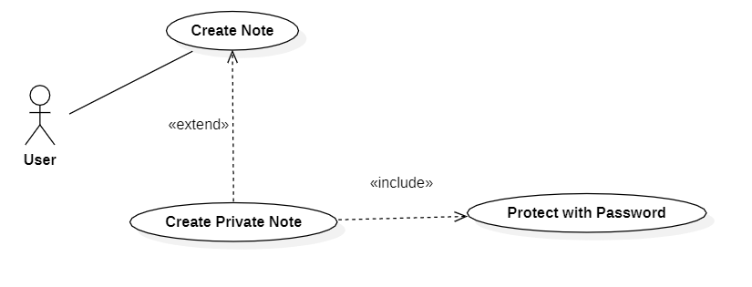
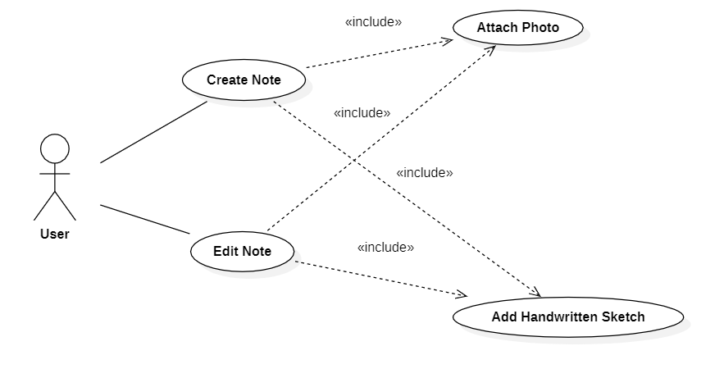
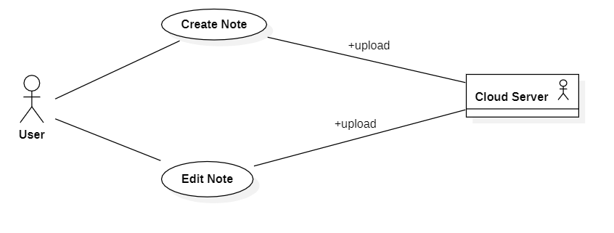
Use Case Diagram

Slide 3
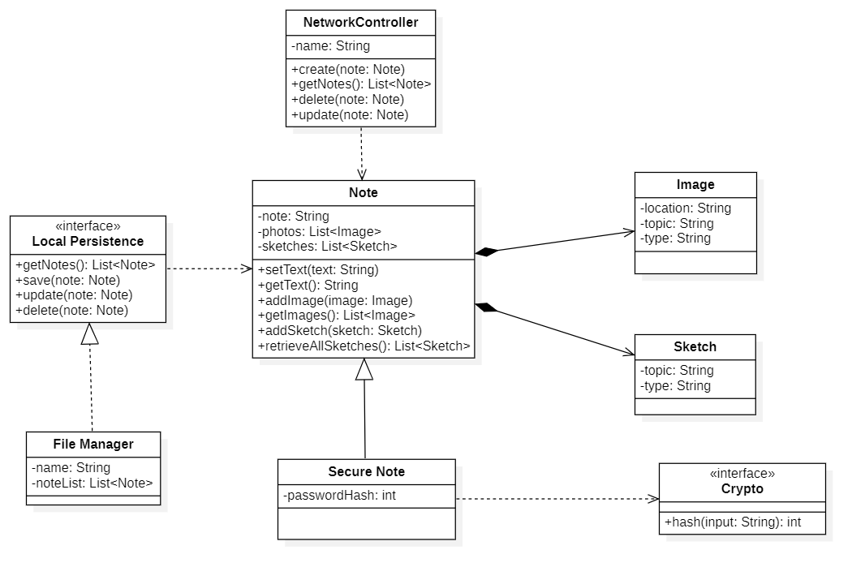
Class Diagram

Slide 4

Implementation
https://github.com/MinhQuang110786/MinhQuang110786.github.io/tree/master/Java%20co%20ban/src/noteTakingApp

Slide 5

Thank you for listening

